Slide 1
CSE 438: Data Science For Practitioners Paper Review
A Secure Big Data Storage Framework Based on Blockchain Consensus Mechanism With Flexible Finality
A. Sasikumar, Logesh Ravi, Ketan Kotecha, Ajith Abraham, Malathi Devarajan, Subramaniyaswamy Vairavasundaram
Published Year: 2023
Paper Reviewed by
Saurav Das ID: 20101100
Section: 01
Group: 14
ST - Mehnaz Ara Fazal
RA - Md Sabbir Hossain
Course Instructor: Annajiat Alim Rasel

Slide 2
Introduction
This paper proposes a secure big data storage framework based on blockchain consensus mechanism with flexible finality. The framework leverages blockchain technology to ensure data security and integrity, addressing challenges such as scalability, non-tampering, trustworthiness, data governance, and transparency.
1

Slide 3
1. Summary Slide Number
1.1 Motivation -------------------------------------------------------- 3
1.2 Contribution ------------------------------------------------------ 4
1.3 Methodology ----------------------------------------------------- 5
1.4 Conclusion -------------------------------------------------------- 6
2. Limitations --------------------------------------------------------------- 8
3. Synthesis
3.1 Analysis of the paper ------------------------------------------- 9
3.2 Future Work ----------------------------------- 10
2

Slide 4
1.1 Motivation
Data security and integrity are becoming increasingly important as the volume of data being created and stored grows.
Existing big data security systems provided by controlled third parties are susceptible to several security risks.
Blockchain technology plays a vital role in resolving current technology challenges, including scalability, non-tampering, trustworthiness, data governance, and transparency.
The proposed research aims to address real-time big data storage issues by leveraging blockchain technology and applying a highway protocol to generate new blocks.
The proposed framework allows for dynamic control of data manipulation and continuous support for individuals to participate in the data-sharing process.
3

Slide 5
1.2 Contribution
The research proposes a secure data storage framework using a decentralized blockchain network, leveraging blockchain's decentralized and immutable characteristics.
The framework is based on the blockchain architecture and utilizes the highway protocol to create blocks in the network.
A flexible finality condition-based trustability validation model is introduced for new block creation in the big data storage environment to verify user authentication.
The research employs a flexible finality condition that deals with verifying new blocks and protecting the distributed data storage network.
The performance of the blockchain-based big data storage framework is evaluated on metrics such as hit ratio and transaction time for file transfer operations, compared to baseline approaches.
4

Slide 6
1.3 Methodology
The research paper proposes a methodology for secure big data storage based on a blockchain consensus mechanism with flexible finality.
The methodology involves leveraging blockchain technology and applying a highway protocol to generate new blocks in the big data storage environment.
The highway protocol allows for the configuration of security thresholds more freely and enables blocks with lower thresholds to reach finality more quickly.
The proposed methodology also focuses on addressing real-time big data storage issues and ensuring data security, integrity, scalability, trustworthiness, data governance, and transparency.
The performance of the proposed methodology is evaluated through experiments conducted in a dynamic and heterogeneous computing environment, using different blockchain platforms for comparison
5

Slide 7
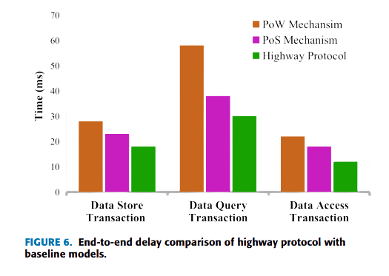
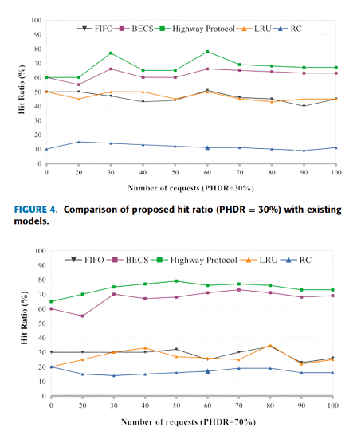
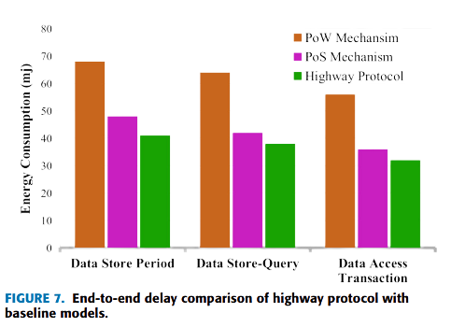
1.4 Conclusion
6

Slide 8
1.4 Conclusion
The research paper proposes a secure big data storage framework based on a blockchain consensus mechanism with flexible finality.
The framework leverages blockchain technology and applies a highway protocol to generate new blocks, allowing for more flexible security thresholds and quicker finality for blocks with lower thresholds.
The proposed framework addresses challenges such as scalability, non-tampering, trustworthiness, data governance, and transparency in big data storage.
Experimental results show that the proposed framework outperforms baseline models in terms of hit ratio and provides efficient data processing and energy consumption.
The research contributes to the field by introducing a new approach to big data storage security that utilizes blockchain technology and allows for dynamic control of data manipulation and participation in the data-sharing process.
7

Slide 9
2. Limitations
Verification and validation challenges:
Public consensus (PoW or PoS) for big data storage.
Costly and energy-consuming operations.
Communication and energy consumption issues:
High costs and energy consumption in decentralized big data storage.
Security concerns:
Ineffectiveness of standard security solutions.
Challenges in data generation, accessibility control, and cyber security accounting.
Blockchain and edge computing compatibility issues:
Integration challenges between blockchain and edge computing.
Scalability and network coverage limitations:
Challenges due to varying IoT data sizes affecting scalability and network coverage.
Storage efficiency challenges:
Limited capacity in edge nodes.
Inefficient data exchange impacting network throughput.
8

Slide 10
3.1 Analysis of the Paper
The paper addresses the increasing importance of data security and integrity in big data storage
It proposes a new approach based on blockchain technology and a highway protocol to address real-time big data storage issues
Security concerns of big data, including counterfeit data, access control, and distributed storage and computation, are discussed
A consensus mechanism based on the highway protocol with flexible finality conditions is introduced to improve data transaction rates and reduce energy consumption
The proposed framework is evaluated against existing models, demonstrating higher transaction rates and reduced energy usage
The paper emphasizes the importance of decentralized data storage and outlines future research directions for energy-efficient consensus mechanisms
9

Slide 11
3.2 Future Work
Development of energy-efficient consensus mechanisms for edge computing data transfer in the context of big data
Practical implementation of the proposed framework in real-world big data storage systems
Research into enhancing the security and privacy aspects of the framework
Exploration of ways to further enhance the scalability and mobility of the framework
Comparative studies with other emerging technologies and frameworks to benchmark performance
10

